Slide 1
An Overview of RTCA DO-178B
              RTCA DO-178B
- S/W considerations in Airborne systems and equipment certification

Slide 2

What is DO-178B?
Titled “Software Considerations in Airborne Systems and Equipment Certification”.
It’s European equivalent is ED-12B.
A document that addresses the life process of developing embedded software in aircraft systems.
A guideline of best practices for safety critical software development on airborne systems

Slide 3
Why DO-178B?
Safety:
Safety is a property of a system that it will not endanger human life or the environment.
Safety-Critical System:
A system that is intended to achieve, on its own, the necessary level of safety integrity for the implementation of the required safety functions.

Slide 4
PURPOSE OF DO178B
To Provide Guidelines for the production of Software for airborne systems and equipment that perform its intended function with a level of confidence in safety that complies with airworthiness requirements.
The guidelines are in the form of :
Objectives of Software life cycle processes
Description of activities and design considerations for achieving those objectives
Description of evidence that indicate that the objectives have been satisfied.

Slide 5
HISTORY OF DO-178B
The RTCA creates DO-178 in 1980.
The first version, DO-178 covered the basic avionics software life cycle.
The second version, DO-178A, added avionics software criticality level details and emphasized software component testing to obtain quality.
DO-178B, evolved avionics software quality via added planning, continuous quality monitoring, and testing in real-world conditions

Slide 6
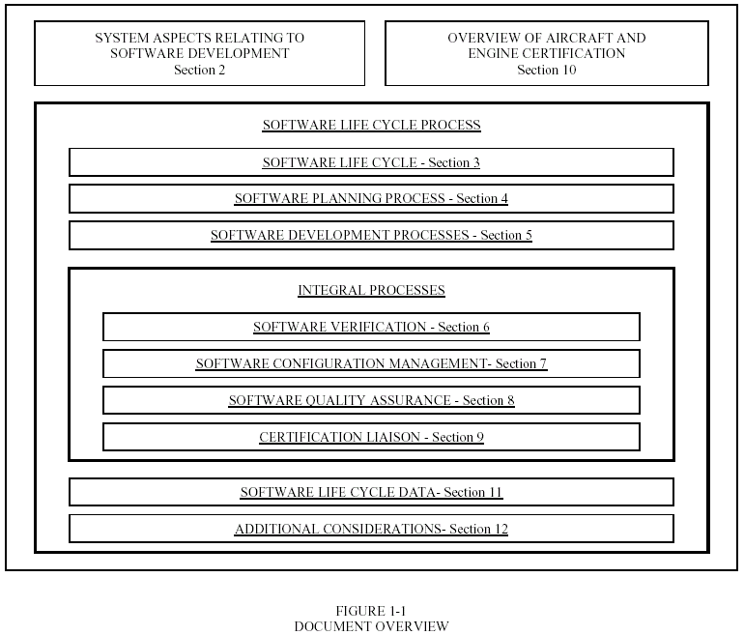
DO-178B DOCUMENT LAYOUT

Slide 7
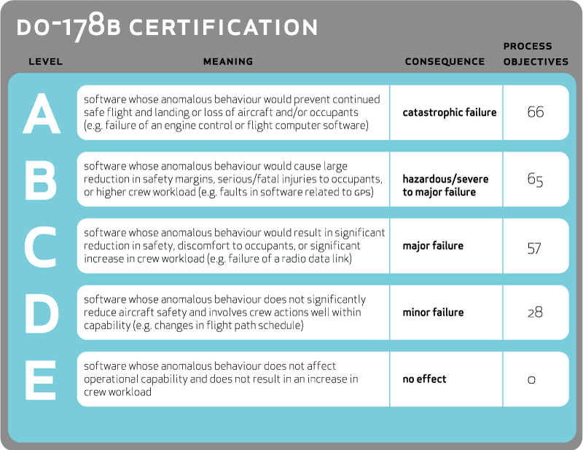
DO-178B SOFTWARE LEVELS

Slide 8

DO-178B PROCESSES & OUTPUTS
DO-178B is divided into six main processes:
  Software Planning
  Software Development
  Software Verification
  Software Configuration Management
  Software Quality Assurance
  Certification Liaison
Each process has a set of expected documented outputs.

Slide 9
SOFTWARE PLANNING PROCESS
Activities addressing system requirements and certification levels
Inter-relationships between processes, sequencing, feedback, and transition criteria
Life cycle environment, including methods and tools
Software development standards
Software plans that comply with DO178B
Coordination of development and revisions to plans

Slide 10
SOFTWARE PLANNING PROCESS - OUTPUTS
  Plan for Software Aspects of Certification (PSAC)
  Software Development Plan (SDP)
  Software Verification Plan (SVP)
  Software Configuration Management Plan (SCMP)
  Software Quality Assurance Plan (SQAP)
  Software Requirement Standards (SRS)
  Software Design Standards (SDS)
  Software Coding Standards (SCS)

Slide 11

SOFTWARE DEVELOPMENT PROCESS
Software Requirements Process
  High-level requirements in relation to function, performance, interface and safety.
Software Design Process
  Low-level requirements used to implement the source code.
Software Coding Process
  Production of source-code from the design process.
Integration Process
  Integration of code into a real-time environment.

Slide 12

SOFTWARE DEVELOPMENT PROCESS Contd...
The following outputs are the result of the combined four sub-processes:
  Software requirements data (SRD)
  Software design description (SDD)
  Source code
  Executable object code

Slide 13
SOFTWARE VERIFICATION PROCESS
The purpose is to identify and report any errors resulting from the development process.
The verification process objectives can be met with reviews, walk through, unit testing, integration testing, and more.
Outputs include:
  Software Verification Cases and Procedures
  Software Verification Results
    Review of all requirements, design and code
    Testing of executable object code
    Code coverage analysis

Slide 14

SOFTWARE CONFIGURATION MANAGEMENT PROCESS
The purpose is to establish secure and effective configuration control for all artifacts.
The following activities are done within the process:
        Configuration Identification
        Change Control
        Baseline establishment
        Archiving of the software
Outputs include:
      Software Configuration Index ( SCI)
      Software Life Cycle Environment Configuration Index (SECI)

Slide 15
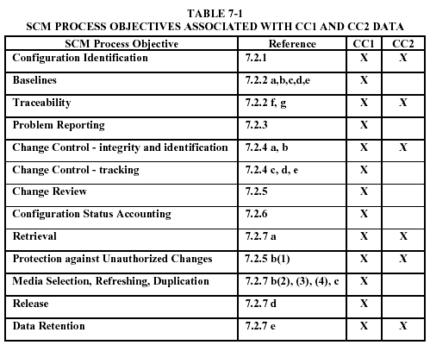
SCM PROCESS (CONTD…)

Slide 16
SOFTWARE QUALITY ASSURANCE PROCESS
The purpose is to provide assurance that the software life cycle process is going to yield quality software.
Each process is analyzed to show that each process is producing the expected outputs.
Any changes from originally proposed plans are reported, evaluated, and resolved to ensure process integrity.

Slide 17
SOFTWARE QUALITY ASSURANCE PROCESS
Outputs:
  Software quality assurance records (SQAR)
  Software conformity review (SCR)
  Software accomplishment summary (SAS)

Slide 18
DO-178B CERTIFICATION
D0-178B very specifically addresses the following which directly affects product development.
  Certification of a product applies only to it's finished result.
  Certification includes approval of all systems and subsystems, hardware, software, firmware, development tools, production, and testing of the product.
  Certification is done on the individual application of the product
  Coding practices must be certified to ensure things like "dead code" are not allowed.
  Certification requires that 'full testing' of the system and all of it's components (including firmware) be done on the target platform in the target environment.
  Certification requires code testing at the MCDC level.

Slide 19
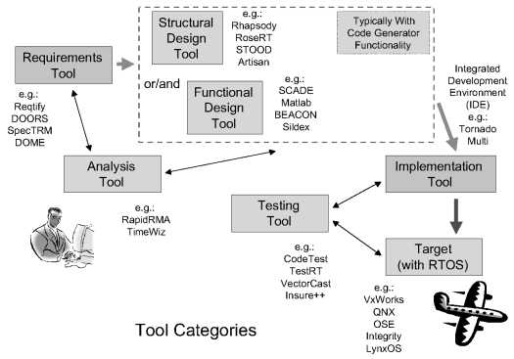
DO-178B DEVELOPMENT TOOLS

Slide 20
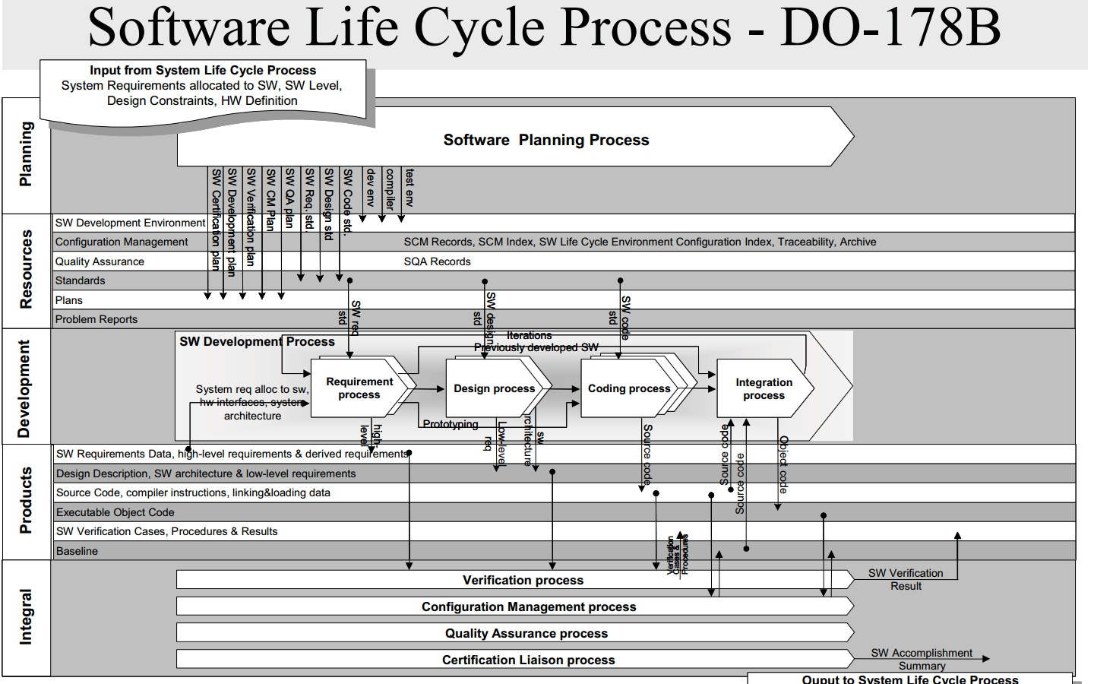

Slide 21
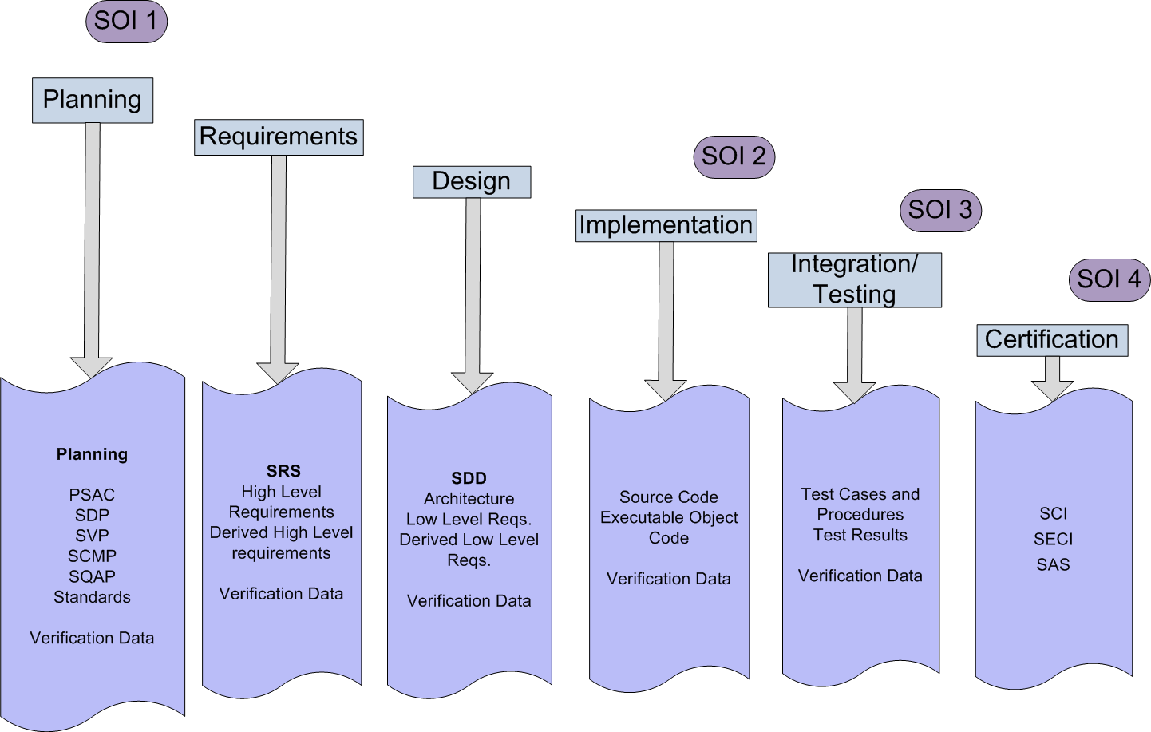
CERTIFICATION ROAD MAP

Slide 22


